Slide 1

Future Sales Prediction with Machine Learning

Slide 2
What is machine learning?
Machine learning (ML) is a type of artificial intelligence (AI) that allows software applications to become more accurate at predicting outcomes without being explicitly programmed to do so. Machine learning algorithms use historical data as input to predict new output values.

Slide 3
Why is machine learning important?
Machine learning is important because it gives enterprises a view of trends in customer behavior and business operational patterns, as well as supports the development of new products. Many of today's leading companies, such as Facebook, Google and Uber, make machine learning a central part of their operations. Machine learning has become a significant competitive differentiator for many companies.

Slide 4
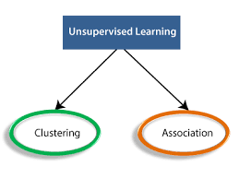
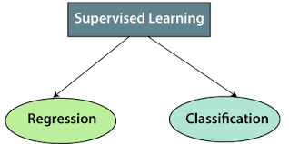
Machine Learning Techniques
Unsupervised Techniques
Supervised Techniques

Slide 5
Who's using machine learning and what's it used for?
Facebook uses machine learning to personalize how each member's feed is delivered. If a member frequently stops to read a particular group's posts, the recommendation engine will start to show more of that group's activity earlier in the feed.
Behind the scenes, the engine is attempting to reinforce known patterns in the member's online behavior. Should the member change patterns and fail to read posts from that group in the coming weeks, the news feed will adjust accordingly.

Slide 6
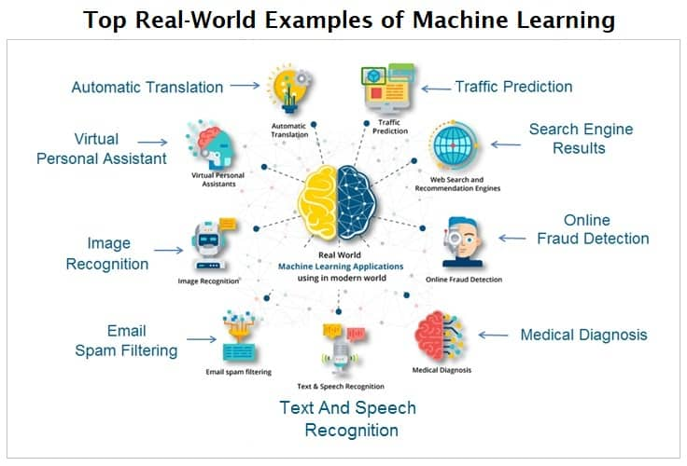
Examples of Machine Learning

Slide 7
Sales Forecast Prediction
Forecast prediction is predicting a future value using past values and many other factors.
It is determining present-day or future sales using data like past sales, seasonality, festivities, economic conditions, etc.
In this model 8 parameters were used as input:
past seven day sales
day of the week
date – the date was transformed into 3 different inputs
season
Festival or not
sales on the same day in the previous year

Slide 8
How does it work
First, all inputs are preprocessed to be understandable by the machine. This is a linear regression model based on supervised learning, so the output will be provided along with the input. Then inputs are then fed to the model along with desired output. The model will plot(learn) a relation(function) between the input and output. This function or relation is then used to predict the output for a specific set of inputs. In this case, input parameters like date and previous sales are labeled as input, and the amount of sales is marked as output

Slide 9
Required packages and Installation
numpy
pandas
keras
tensorflow
csv
matplotlib.pyplot

Slide 10
Installation
import pandas as pd # to extract data from dataset(.csv file)
import csv #used to read and write to csv files
import numpy as np #used to convert input into numpy arrays to be fed to the model
import matplotlib.pyplot as plt #to plot/visualize sales data and sales forecasting
import tensorflow as tf # acts as the framework upon which this model is built
from tensorflow import keras #defines layers and functions in the model
#here the csv file has been copied into three lists to allow better availability
list_row,date,traffic = get_data('/home/abh/Documents/Python/Untitled Folder/Sales_dataset')

Slide 11
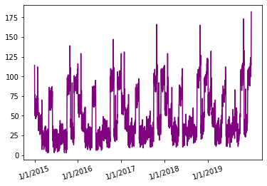
Sales Data for 5 Years
As you can see, the sales data seems to be following a similar kind of pattern for each year and the peak sales value seems to be increasing with time over the 5-year time frame.
In this 5-year time frame, the first 4 years will be used to train the model and the last year will be used as a test set.

Slide 12
What are supervised and unsupervised techniques?
supervised learning uses labeled input and output data, while an unsupervised learning algorithm does not. In supervised learning, the algorithm “learns” from the training dataset by iteratively making predictions on the data and adjusting for the correct answer.
Some examples of unsupervised learning algorithms include K-Means Clustering, Principal Component Analysis and Hierarchical Clustering.
Some popular examples of supervised machine learning algorithms are: Linear regression for regression problems.

Slide 13
Algorithm is used for sales prediction?
The Random Forest Regression algorithm performed well after do- ing all the study when compared with other algorithms. Hence the Random Forest Regression is considered as the best suitable algorithm for forecasting product sales.
So, the overall regression equation is Y = bX + a, where:
X is the independent variable (number of sales calls)
Y is the dependent variable (number of deals closed)
b is the slope of the line.
a is the point of interception, or what Y equals when X is zero.

Slide 14
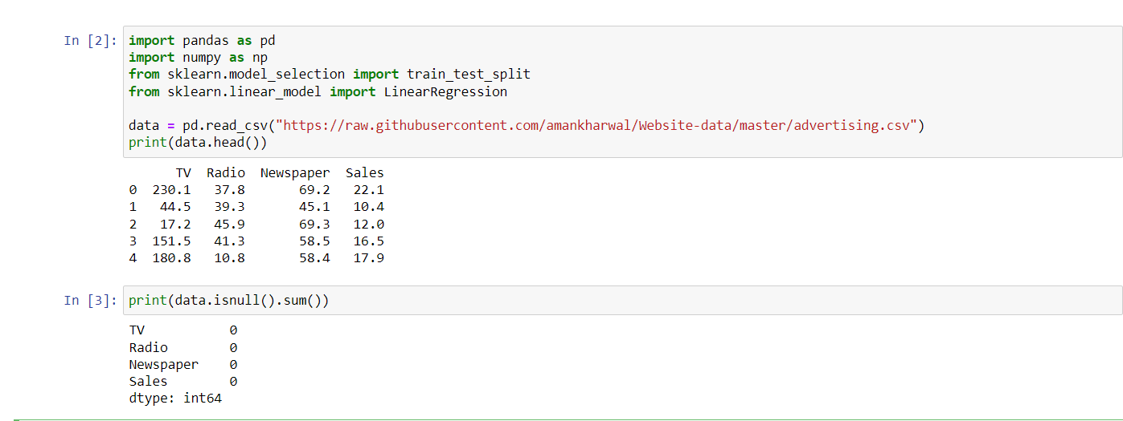
Future Sales Prediction using Python

Slide 15
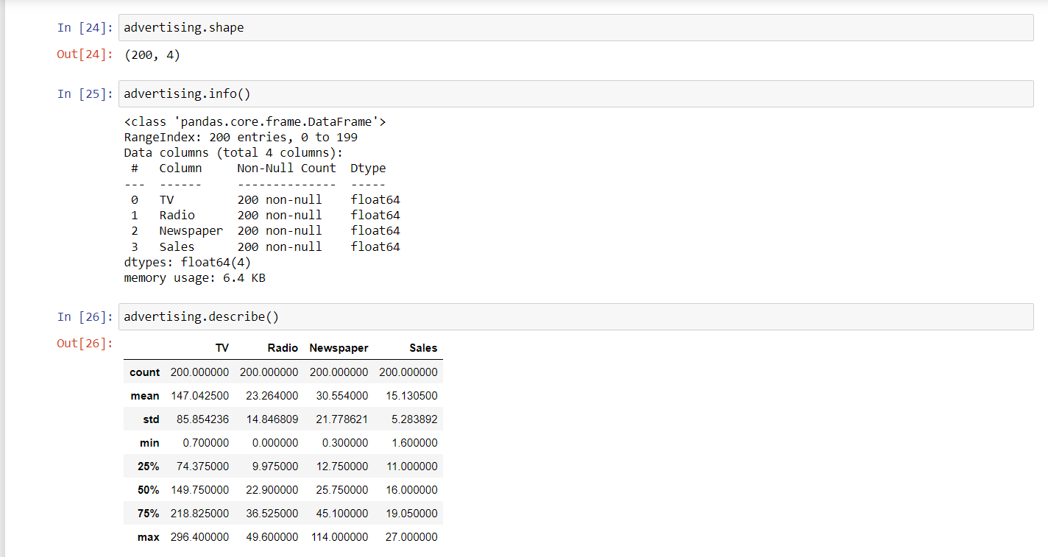
Data Inspection

Slide 16
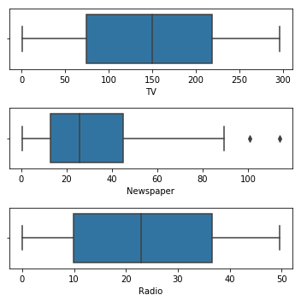
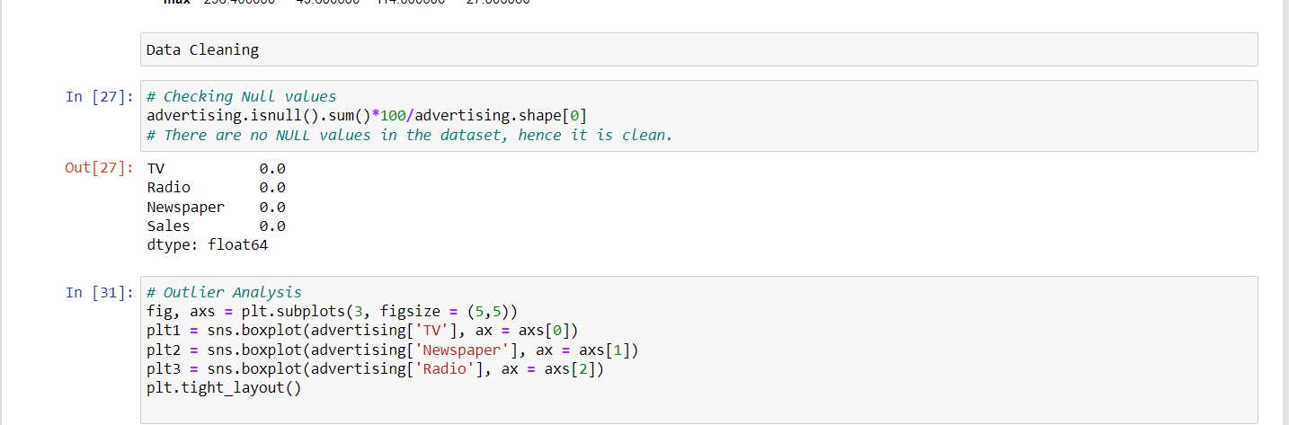
Data Cleaning

Slide 17
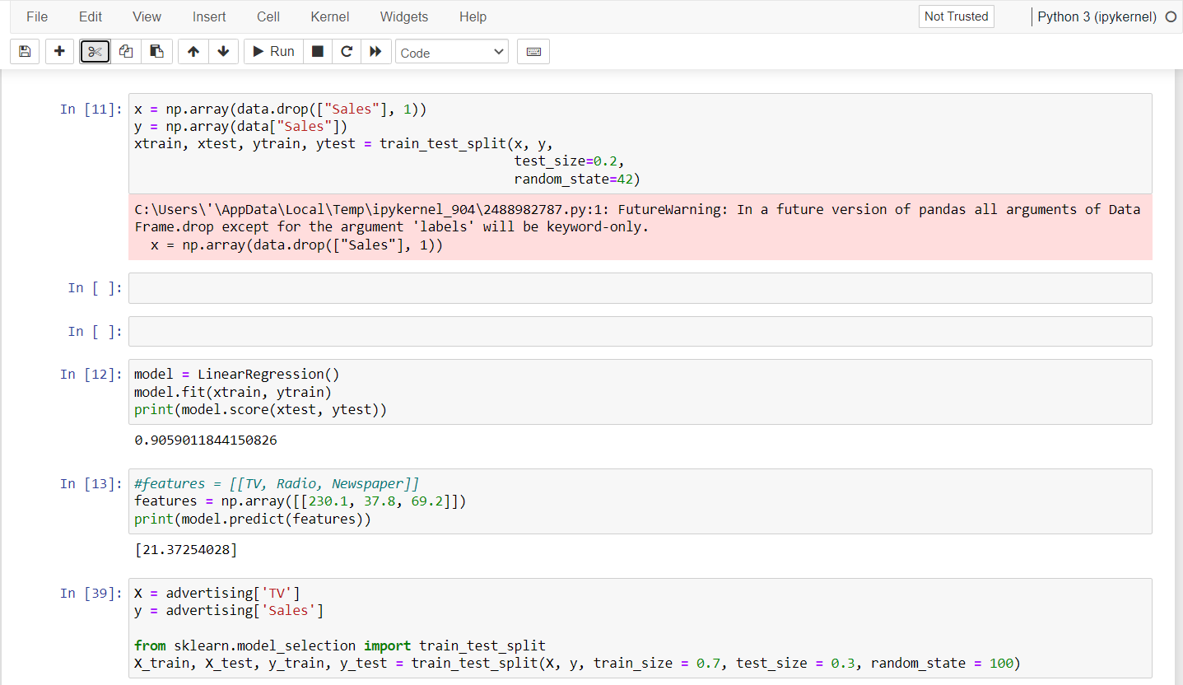
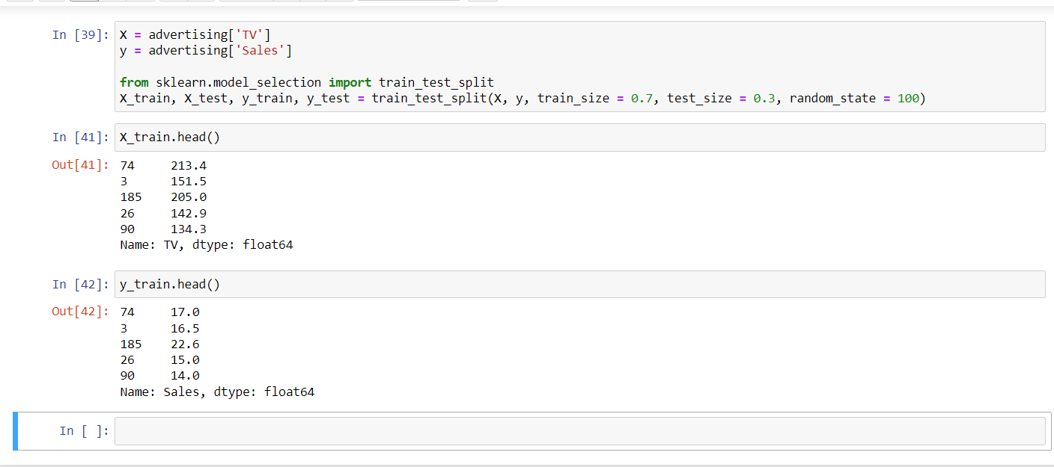
Train-Test Split

Slide 18

What is big Mart sales prediction?
The aim is to build a predictive model and find out the sales of each product at a particular store. Using this model, BigMart will try to understand the properties of products and stores which play a key role in increasing sales.

Slide 19
Future Sales Prediction
The dataset given here contains the data about the sales of the product. The dataset is about the advertising cost incurred by the business on various advertising platforms. Below is the description of all the columns in the dataset:
TV: Advertising cost spent in dollars for advertising on TV;
Radio: Advertising cost spent in dollars for advertising on Radio;
Newspaper: Advertising cost spent in dollars for advertising on Newspaper;
Sales: Number of units sold;

Slide 20
How & Why ?
The value of machine learning is rooted in its ability to create accurate models to guide future actions and to discover patterns that we've never seen before.
Machine learning can increase the speed at which data is processed and analyzed, making it a useful technology for predictive analytics programs. Using machine learning, predictive analytics algorithms can train on even larger data sets and perform deeper analysis on multiple variables with minor changes in deployment.

Slide 21
What is the future of machine learning?
While machine learning algorithms have been around for decades, they've attained new popularity as artificial intelligence has grown in prominence. Deep learning models, in particular, power today's most advanced AI applications.
Machine learning platforms are among enterprise technology's most competitive realms, with most major vendors, including Amazon, Google, Microsoft, IBM and others, racing to sign customers up for platform services that cover the spectrum of machine learning activities, including data collection, data preparation, data classification, model building, training and application deployment.
As machine learning continues to increase in importance to business operations and AI becomes more practical in enterprise settings, the machine learning platform wars will only intensify.

Slide 22
Presented By
RojaSri Vadlamuri & Sharmila Madugula

